Slide 1
HOMEWORK 5 Due 4/17 00:00 send to e3

Slide 2
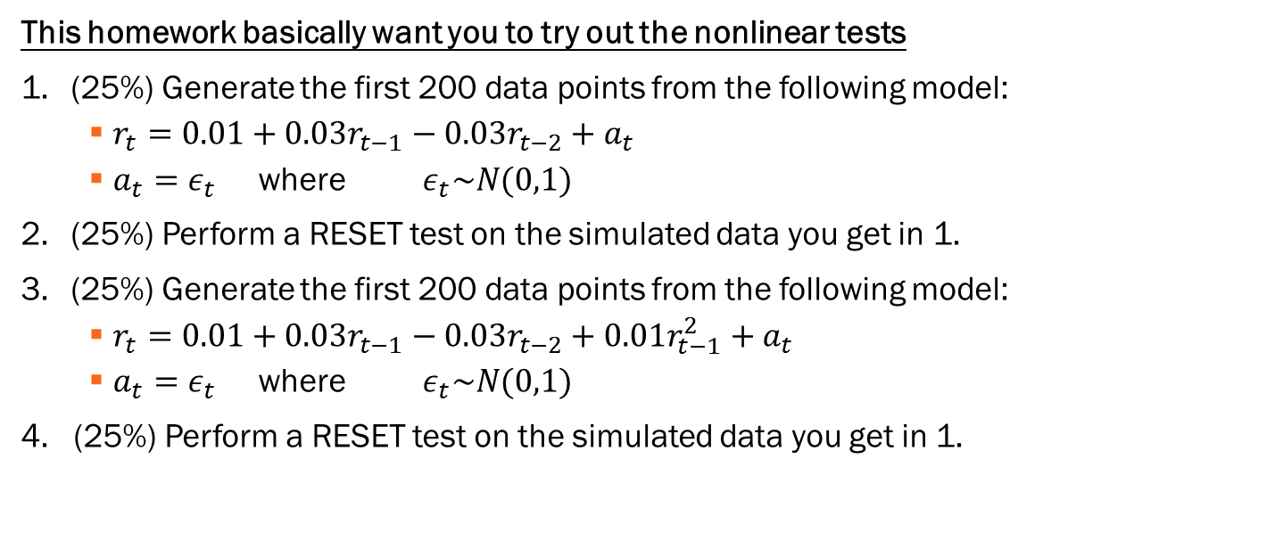
This homework basically want you to try out the nonlinear tests
(25%) Generate the first 200 data points from the following model:
$r_{t}=0.01+0.03r_{t−1}−0.03r_{t−2}+a_{t}$
$a_{t}=ε_{t}$ where $ε_{t}\sim N(0,1)$
(25%) Perform a RESET test on the simulated data you get in 1.
(25%) Generate the first 200 data points from the following model:
$r_{t}=0.01+0.03r_{t−1}−0.03r_{t−2}+0.01r_{t−1}^{2}+a_{t}$
$a_{t}=ε_{t}$ where $ε_{t}\sim N(0,1)$
4. (25%) Perform a RESET test on the simulated data you get in 1.

